Slide 1
Backdoors r bad

Slide 2

1.
What is a backdoor?
Oooooh scaryyyy
Notes:
Ask them for their idea of what a backdoor is b4 moving to the next slide

Slide 3
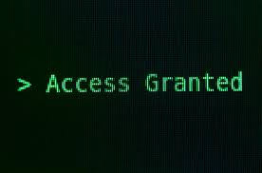
Usage
Persistence
Once a hacker gets in, they need to STAY in
Open up multiple entries into the system

Slide 4
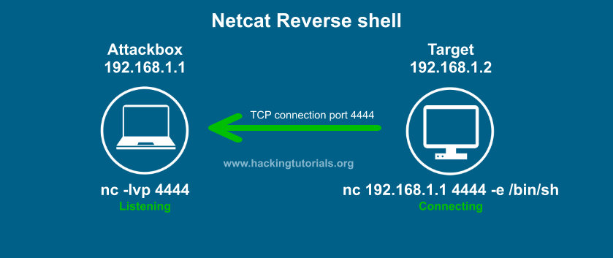
Example 1: Reverse shell
You are sending your shell outbound
Notes:
Reverse shell ex: sending /bin/bash out through nc
Webshell ex: hosting a php system() command in /var/www/html
Insecure remote services ex: downloading telnetd, tightvncserver, openssh, etc.

Slide 5
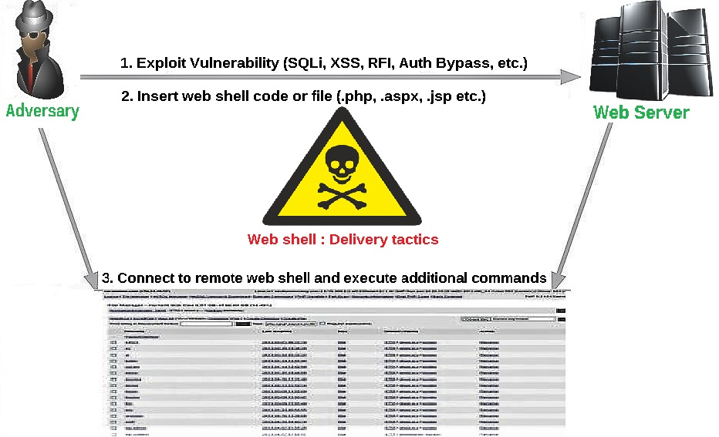
Example 2: Webshell
You are hosting a shell in webroot

Slide 6
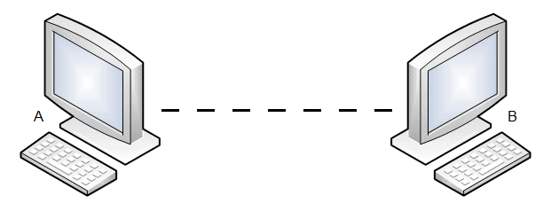
Example 3: Insecure remote services
Opening up services to connect to such as telnetd, tightvncserver, openssh-server, etc.

Slide 7

Be thorough!
If you miss a single backdoor, that’s still an easy point of entry for a hacker

Slide 8

How prevent??
It’s slightly possible

Slide 9

“If you know the enemy and know yourself, you need not fear the result of a hundred battles.”
Some smart dude

Slide 10

Know yourself!
If the hackers understand your systems better than you do, its GAME OVER!

Slide 11

Recon
Red teams run recon to find insecure open ports, services, processes
You should also do this!!

Slide 12

How do?
netstat: shows network statistics about your system
nmap: shows open ports (can even do on REMOTE systems)
lsof: list open files and the processes that opened them

Slide 13

Some common files to check
Crontabs:
Located in /etc/ as well as /var/spool/
Run a command every x interval
Usually * * * * * [backdoor]
/etc/rc.local:
Run a command upon startup

